Slide 1
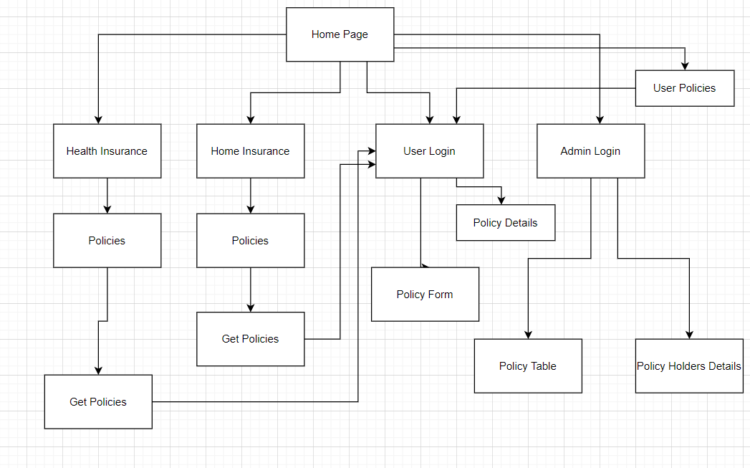

Slide 2
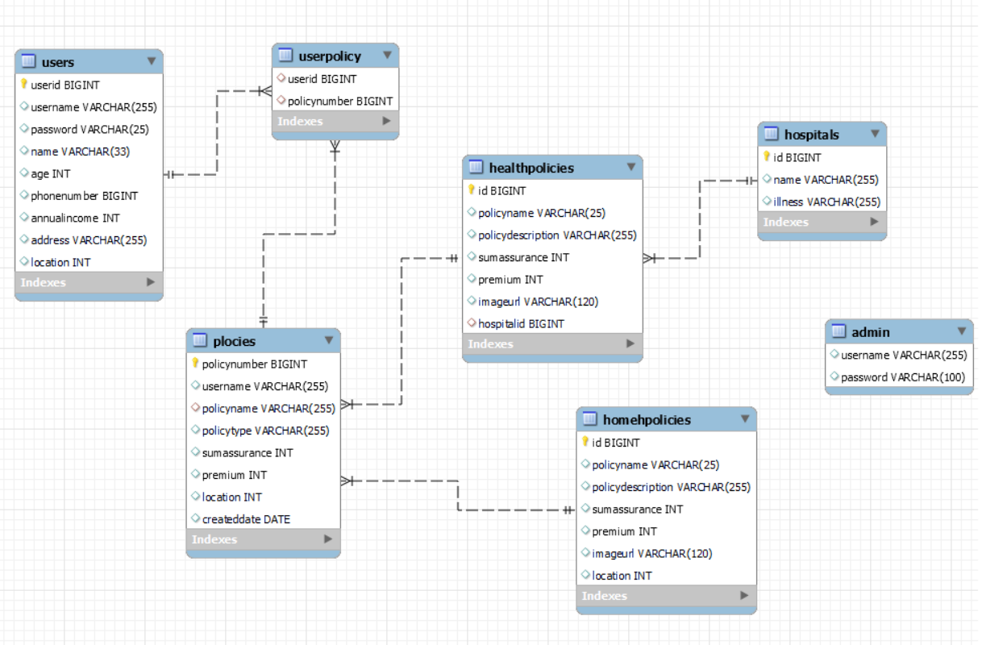

Slide 3
Endpoint | Request | Sample Response
http://localhost:8080/api/users | GET | "userid" : 1, "username" : "Sivan", "password" : "npci", "name" : "sivanayan", "age" : 25, "phonenumber" : 9.87654321E9, "annualincome" : 900000.0, "address" : "Chennai", "location" : 401201,
http://localhost:8080/api/homepolicies | GET | "id" : 1, "policyname" : "sahaya", "policydescription" : "securing home", "sumassurance" : 3500000, "premium" : 20000, "imageurl" : "sah.png", "location" : 431601,
http://localhost:8080/api/healthpolicies | GET | "id" : 8, "policyname" : "ayush", "policydescription" : "covers all", "sumassurance" : 500000, "premium" : 1400, "imageurl" : "ayus.png", "hospitalid" : 1,
http://localhost:8080/api/admin | GET | “List of policy details”
http://localhost:8080/api/admin | DELETE | “Rejecting the listed Policy”
http://localhost:8080/api/admin | UPDATE | “Approving the Policy”

Slide 4

Logo
home
Products
About us
search
Login
Admin Login
carausal
Username:
Password:
Login
Secure Your Life with
Health Insurance
Secure your Home with Home Insurance

Slide 5
Logo
home
Products
About us
search
Login
Health Insurance Policies
Premium Calculator
Select Insurance
________________
Policy 1
Policy 2
________________
Policy 3
Policy 4
Calculate
Policy 5
Policy 6

Slide 6
Logo
home
Products
About us
search
Login
Details of the Selected Policies
Get policy

Slide 7
Logo
home
Products
About us
search
Login Page
Username
Password
Login

Slide 8
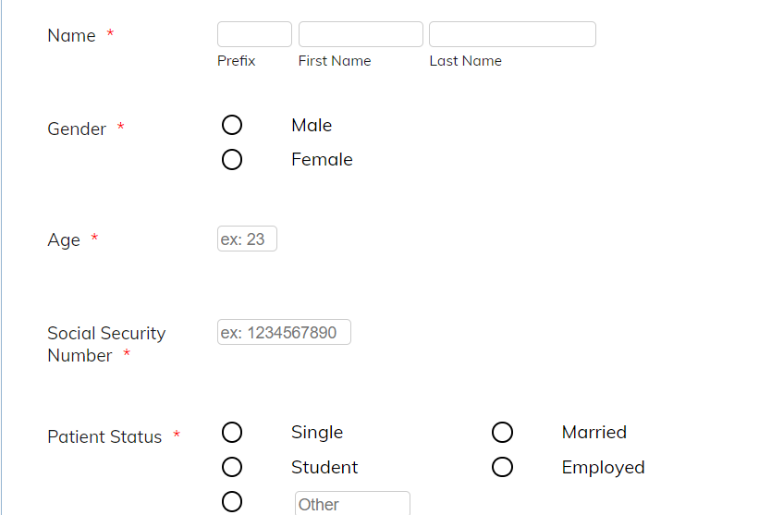
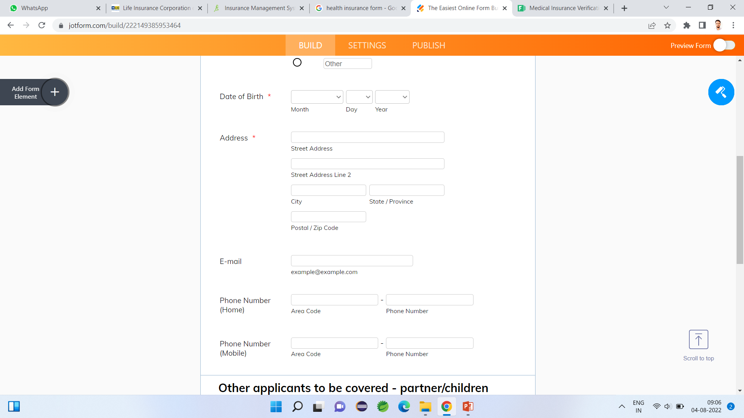
Logo
home
Products
About us
Welcome customer...
search
Insurance Form
Select Insurance
Submit

Slide 9
Logo
home
Admin Login
Logout
Add Policy
Search Policy
Policy Holders
update
delete
update
delete
update
delete
update
delete
update
delete

